Slide 1
Software Engineering and Architecture
Reflections on
Mandatories

Slide 2
DOT & OLoA
Two clean code principles often confuse
  Do One Thing: “But it does multiple things…”
  One Level of Abstraction: “Huh???”
Do One Thing example
  Game’s method attackCard()
    “It does a lot, so it does not obey the ‘do one thing’ principle”
  Yes, it does…
    It does one thing: it executes a card attack
      As seen from the perspective of the “Game”
  [In my Clean Code slides, I am a bit ambiguous about that, sorry]

Slide 3
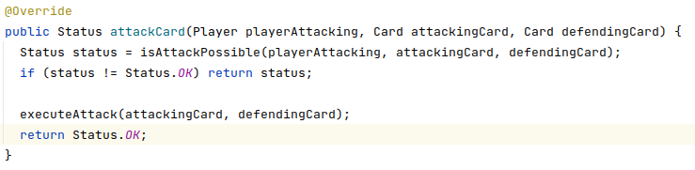
DOT
So ‘Do One Thing’ depends on the perspective and has to be considered from the context
  attackCard is a single function/operation from the ‘user of game’
  But of course, internally (inside the method), it does quite a few things
  These ‘things’ can again be grouped into ‘units of doing one thing’
    Validate that an attack is possible; if so then do the attack

Slide 4
OLoA
One Level of Abstraction
  Tells us that these ‘next level things’ should also be grouped into ‘do one thing’ methods
  … and so on

Slide 5
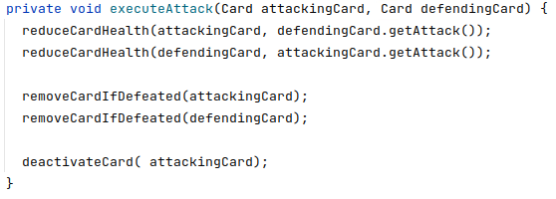
OLoA
As in…

Slide 6
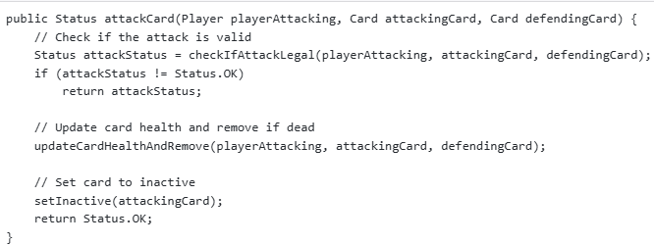
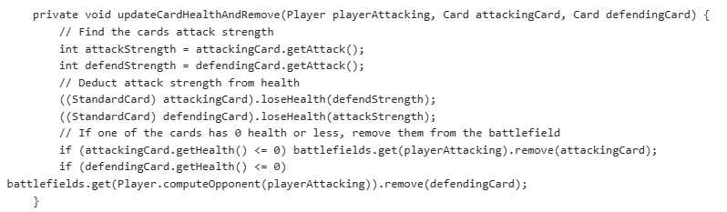
It does not stop at level 1
TAs report multiple examples of ‘stopping at level 1’
  Fine ‘next level of abstraction’
  But next level is just ‘all of it’

Slide 7
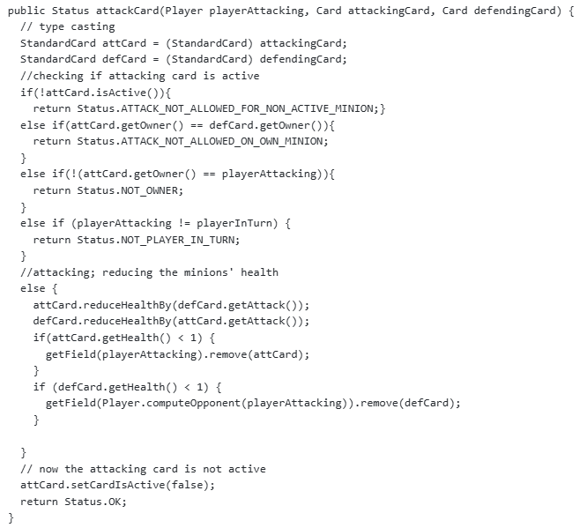
Not more to do?
One group argues this is the final, cleanest code?

Slide 8
Compare with Mine?

Slide 9

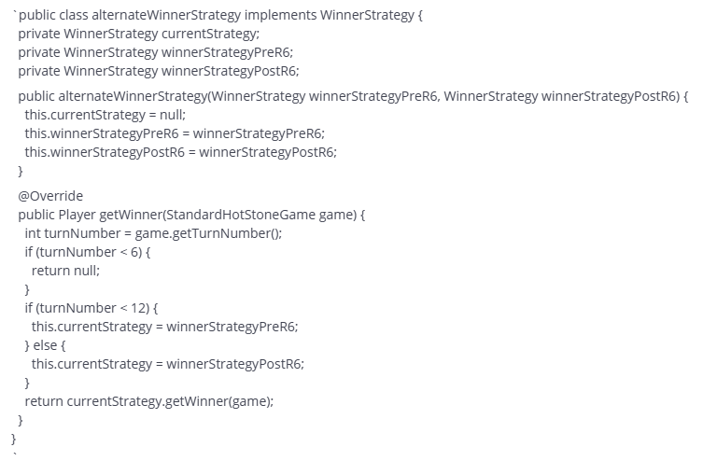
Zeta / State
Mostly correct, but then…
What is the issue
with the marked
code?
Take care ☺
Notes:
It is partial source-code-copy from the GammaStone strategy; What if I select another PreR6 strategy?

Slide 10
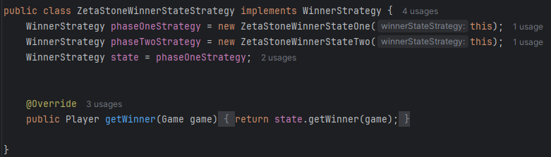
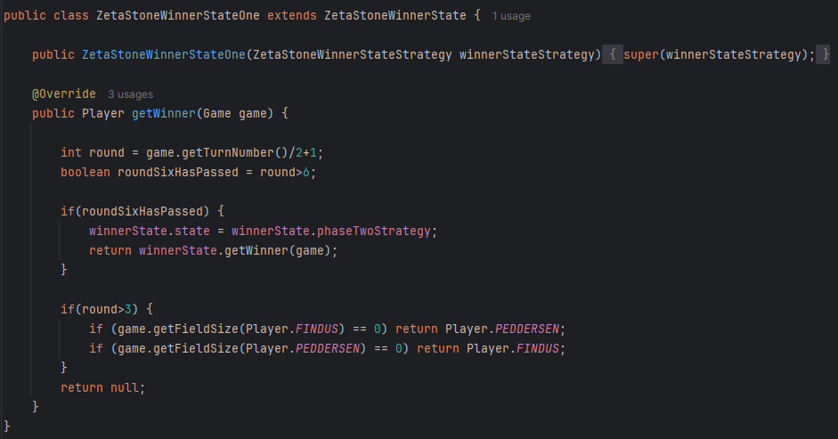
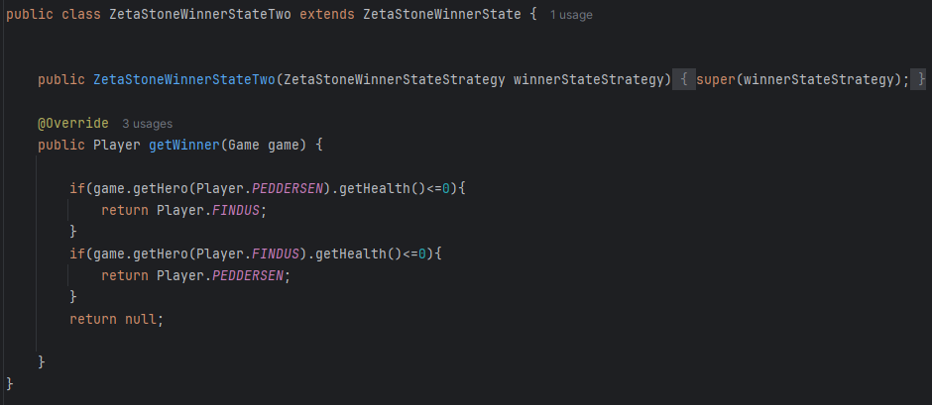
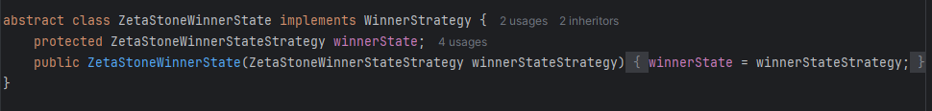
Convoluted Code
Sometimes (especially in a learning context!) we get functional code that is overly complex, and lacks analyzability. Try this:

Slide 11
Convoluted Code
Abstract class? Source-code-copy? Four classes?
  Think: “Aah, this can’t be right???” Do Over

Slide 12
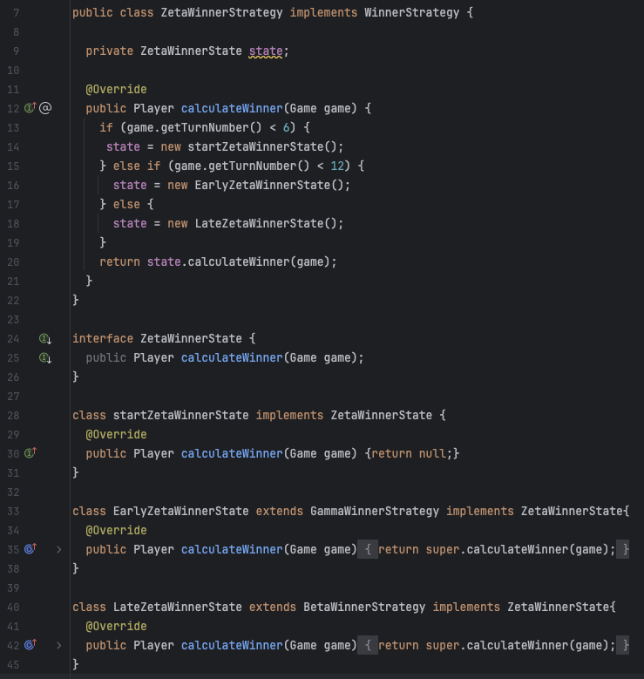
Subclassing
… needed?
  Inheritance used
  just to rename
  a class?

Slide 13
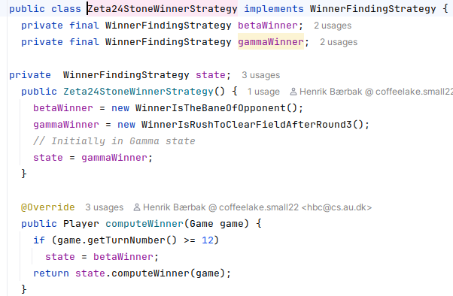
Not Quite as Convoluted
State pattern just delegates to ConcreteState objects
  Store the two strategies, set the starting one
  Switch in case of
  turn passing 12
  Return delegate’s
  opinion on who
  has won…
    Nothing else…
  Compositional
  Design:
    Let someone else
    do the job…

Slide 14
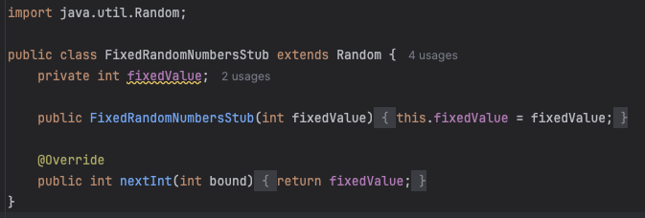
Test Stub for Randomness
Some subclass the Java library ‘Random’ class
  A Double is a replacement of a Depended-On Unit

Slide 15
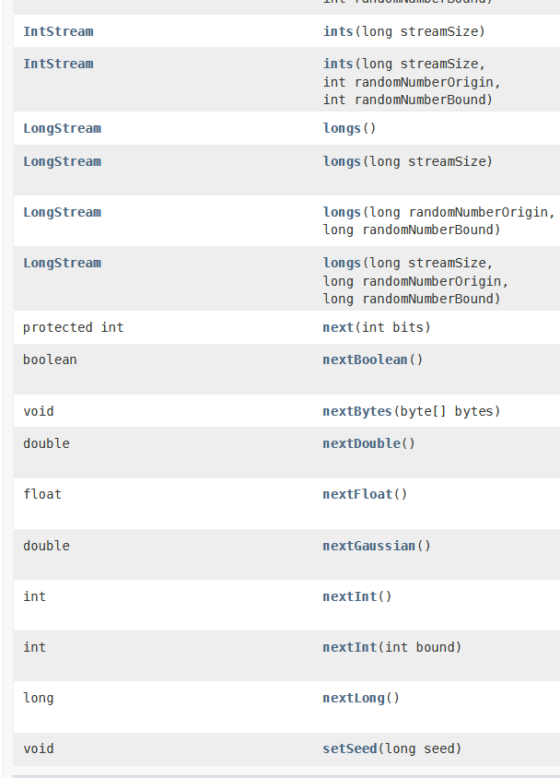
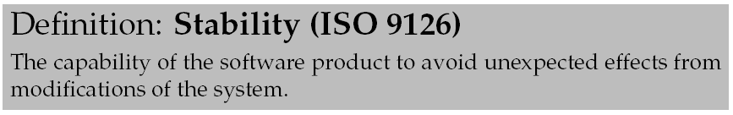
Code Stability
Random contains many methods!
  But only one overridden…
  What if I rewrite my EpsilonStone
  to use nextFloat() instead?
  Answer: Unexpected effects!

Slide 16
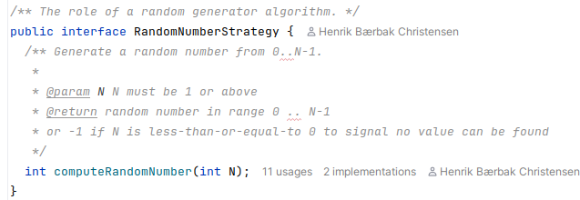
Code Stability
Morale: Let your Test Double define only the single responsibility of ‘make a random index of who to effect on the battle field of size n’
  High cohesion, low coupling

